Slide 1

THERE’S MORE MARKET THAN MEETS THE MLS™
01
Insert random texts you might have
03
Insert random texts you might have
INSERT TOPIC HERE
02
Insert random texts you might have

Slide 2

The Problem.
The real estate industry is reactive.
01
Sellers list only when ready.
02
Buyers only see what’s publicly available.
Meanwhile, hidden supply and strategic buyers remain disconnected.
03
Agents compete over saturated MLS inventory.

Slide 3

The Opportunity.
A massive pre-market layer remains untapped:
30%
of sellers consider selling but never list.
Off-market & and unimproved land represents billions in dormant value.
Buyers are frustrated with low inventory & high competition.
RPM expands the Total Addressable Market (TAM) into the Whole Addressable Market
(WAM).
01
Sellers list only when ready.
02
Buyers only see what’s publicly available.
Meanwhile, hidden supply and strategic buyers remain disconnected.
03
Agents compete over saturated MLS inventory.
Agents reach clients sooner, smarter, and more strategically.
Buyers gain access to exclusive, unlisted opportunities.
Sellers can quietly test a reserve price.

Slide 4

How It Works
What Is Reserve Price Market?
A pre-market real estate platform where:
Agents reach clients sooner, smarter, and more strategically.
Buyers gain access to exclusive, unlisted opportunities.
Sellers can quietly test a reserve price.
30%
of sellers consider selling but never list.
Off-market & and unimproved land represents billions in dormant value.
Sellers (or their agents) set a confidential reserve price.
Buyers are frustrated with low inventory &amp; high competition.
RPM notifies qualified buyers who meet intent thresholds.
RPM expands the Total Addressable Market into the Whole Addressable Market
(WAM).
Smart contracts enable secure, limited-time disclosures.
If buyer interest meets reserve criteria, negotiation begins.

Slide 5
CRM-READY AGENT PORTALS
Broker adoption made simple.
AI BEHAVIORAL SIGNAL MODELING
Predict buyer/seller intent.
GIS + PUBLIC DATA INTEGRATION
Identify unlisted/unimproved property.
RESERVE PRICE ENGINE
Confidential pricing logic.
SMART CONTRACTS (BLOCKCHAIN)
Secure offer handling.
How It Works
Sellers (or their agents) set a confidential reserve price.
RPM notifies qualified buyers who meet intent thresholds.
Smart contracts enable secure, limited-time disclosures.
If buyer interest meets reserve criteria, negotiation begins.
Sellers can quietly test a reserve price.
Buyers gain access to exclusive, unlisted opportunities.
Agents reach clients sooner, smarter, and more strategically.

Slide 6
SMART CONTRACTS (BLOCKCHAIN)
Secure offer handling.
RESERVE PRICE ENGINE
Confidential pricing logic.
GIS + PUBLIC DATA INTEGRATION
Identify unlisted/unimproved property.
AI BEHAVIORAL SIGNAL MODELING
Predict buyer/seller intent.
CRM-READY AGENT PORTALS
Broker adoption made simple.
Technology Stack
Sellers (or their agents) set a confidential reserve price.
NAR Clear Cooperation Policy 8.0 opens doors for compliant pre-market activity.
RPM notifies qualified buyers who meet intent thresholds.
Smart contracts enable secure, limited-time disclosures.
Sellers demand more control.
PropTech adoption is accelerating.
Buyers demand less competition.
If buyer interest meets reserve criteria, negotiation begins.

Slide 7

CRM-READY AGENT PORTALS
Broker adoption made simple.
AI BEHAVIORAL SIGNAL MODELING
Predict buyer/seller intent.
GIS + PUBLIC DATA INTEGRATION
Identify unlisted/unimproved property.
RESERVE PRICE ENGINE
Confidential pricing logic.
SMART CONTRACTS (BLOCKCHAIN)
Secure offer handling.
Why Now?
PropTech adoption is accelerating.
Buyers demand less competition.
NAR Clear Cooperation Policy 8.0 opens doors for compliant pre-market activity.
Sellers demand more control.

Slide 8
PropTech adoption is accelerating.
Buyers demand less competition.
NAR Clear Cooperation Policy 8.0 opens doors for compliant pre-market activity.
Sellers demand more control.
Traction and Milestones
Patent filed (2025).
MVP design and smart contract flows complete.
Active broker onboarding pilots.
Strategic relationships forming with top NYC firms.
$149 per Reserve Price Activation.
SaaS platform fee for brokers/agents.
API Licensing to third-party CRMs/proptech firms.
Optional Smart Contract revenue (per executed contract).
Notes:
This statement means that our company is in the process of developing partnerships with leading real estate firms in New York City. By forming these relationships, the company aims to strengthen its presence in the market, gain valuable industry credibility, and accelerate the adoption of its platform among influential industry players. Working closely with top firms can help open new business opportunities and enable the company to reach more brokers, agents, and clients through established networks.

Slide 9
PropTech adoption is accelerating.
Buyers demand less competition.
NAR Clear Cooperation Policy 8.0 opens doors for compliant pre-market activity.
Sellers demand more control.
Business Model
4
1
2
3
$149 per Reserve Price Activation.
SaaS platform fee for brokers/agents.
API Licensing to third-party CRMs/proptech firms.
Optional Smart Contract revenue (per executed contract).
Influencer marketing + discrete direct outreach.
Land investors, developers, and institutional buyers.
Premium agents in high-inventory urban markets.
Early adopter brokerages (Serhant, Douglas Elliman).

Slide 10
$149 per Reserve Price Activation.
SaaS platform fee for brokers/agents.
API Licensing to third-party CRMs/proptech firms.
Optional Smart Contract revenue (per executed contract).
Go-to-Market Strategy
1
2
3
4
Early adopter brokerages (Serhant, Douglas Elliman).
Premium agents in high-inventory urban markets.
Land investors, developers, and institutional buyers.
Influencer marketing + discrete direct outreach.
Insert picture
Insert picture
Insert picture
MICHAEL DALEWITZ
Serial entrepreneur, startup-to-exit specialist.
BOBBY PEREZ
Real estate development
TEDDY BENSON
Behavioral Signal Technology pioneer, sold Channel
Intelligence to Google ($125M).

Slide 11

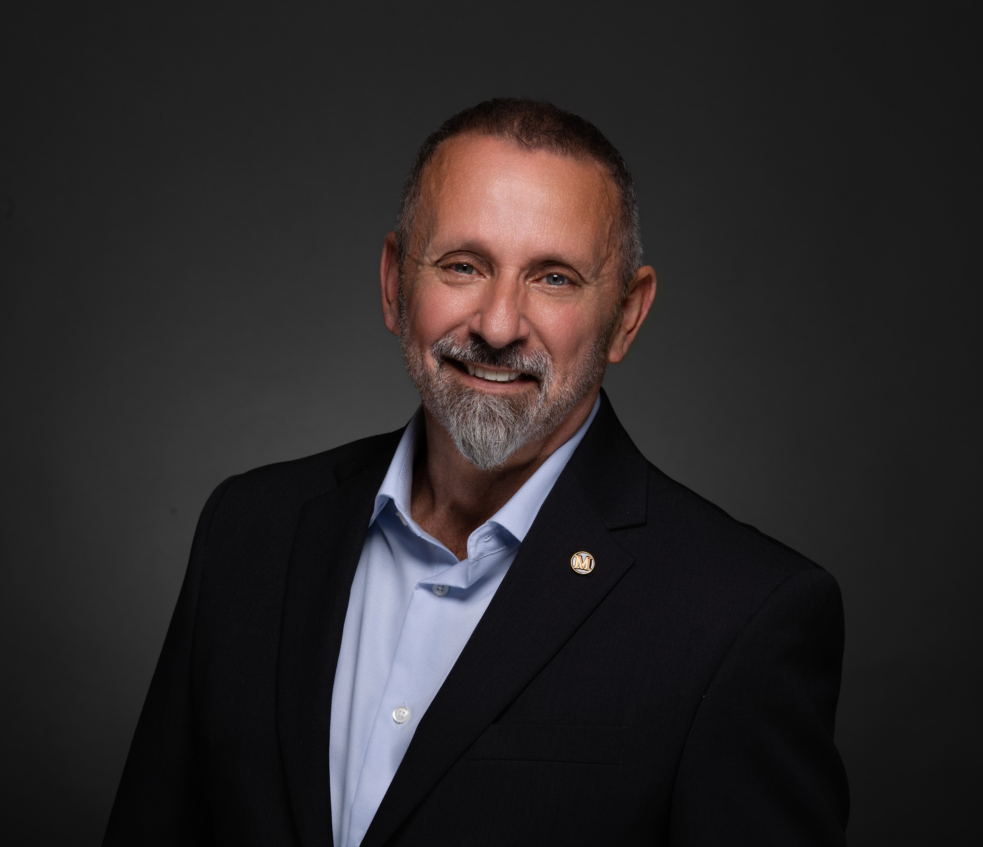

$149 per Reserve Price Activation.
SaaS platform fee for brokers/agents.
API Licensing to third-party CRMs/proptech firms.
Optional Smart Contract revenue (per executed contract).
Team
4
1
2
3
MICHAEL DALEWITZ
Serial entrepreneur, startup-to-exit specialist.
BOBBY PEREZ
Real estate development
TEDDY BENSON
Behavioral Signal Technology pioneer, sold Channel
Intelligence to Google ($125M).
Influencer marketing + discrete direct outreach.
Land investors, developers, and institutional buyers.
Premium agents in high-inventory urban markets.
Early adopter brokerages (Serhant, Douglas Elliman).
WE ARE RAISING [$X] IN SEED CAPITAL TO
Finalize platform development.
Complete API integrations.
Expand broker onboarding.
Launch in top 3 metro markets.

Slide 12
Insert picture
Insert picture
Insert picture
MICHAEL DALEWITZ
Serial entrepreneur, startup-to-exit specialist.
BOBBY PEREZ
Real estate development
TEDDY BENSON
Behavioral Signal Technology pioneer, sold Channel
Intelligence to Google ($125M).
Ask
Finalize platform development.
Complete API integrations.
WE ARE RAISING [$X] IN SEED CAPITAL TO
Launch in top 3 metro markets.
Expand broker onboarding.
Unmatched positioning in a new real estate layer.
Patent-pending, data-integrated engine.
Visionary team with exits and behavioral tech IP.
Compliance-forward and MLS compatible.
Massive TAM, real pain point, elegant solution.

Slide 13
Insert picture
Insert picture
Insert picture
MICHAEL DALEWITZ
Serial entrepreneur, startup-to-exit specialist.
BOBBY PEREZ
Real estate development
TEDDY BENSON
Behavioral Signal Technology pioneer, sold Channel
Intelligence to Google ($125M).
Why Invest in RPM?
Unmatched positioning in a new real estate layer.
Patent-pending, data-integrated engine.
Visionary team with exits and behavioral tech IP.
Compliance-forward and MLS compatible.
Massive TAM, real pain point, elegant solution.

Slide 14
Contact
MICHAEL DALEWITZ – CO-FOUNDER
info@reservepricemarket.com
www.reservepricemarket.com
Unmatched positioning in a new real estate layer.
Patent-pending, data-integrated engine.
Visionary team with exits and behavioral tech IP.
Compliance-forward and MLS compatible.
Massive TAM, real pain point, elegant solution.

